Slide 1
Nikola Ilic
Power BI Performance – 7 Deadly Sins!

Slide 2


Slide 3




data-mozart.com
@DataMozart
Nikola Ilic
learn.data-mozart.com
Consultant & Trainer
I'm making music from the data!
Power BI and SQL addict, blogger, speaker...
Father of 2, Barca & Leo Messi fan...

Slide 4





Creating a Power BI report is an easy task!
@DataMozart
Notes:
Easy Task
User calls
DBA
Not a rocket science

Slide 5

Where do I start?!
Data Model size
Data refresh process
DAX calculations
Visualization rendering time
Storage mode choice
@DataMozart

Slide 6

DATA MODEL SIZE
Notes:
1 GB size limit Pro
Affects 2nd point – data refresh process

Slide 7


DATA MODEL SIZE
VertiPaq is a columnar database
Data snapshot in memory
Periodically refreshed
Formula Engine
Storage Engine
@DataMozart
Notes:
Theoretical background
FE translates DAX to a specific query plan...
SE physically goes through the data

Slide 8

DATA MODEL SIZE
@DataMozart

Slide 9

DATA MODEL SIZE BEST PRACTICES
Reduce the amount of data for import
Reduce the column cardinality
Avoid using calculated columns
Disable Auto Date/Time
@DataMozart

Slide 10

DATA MODEL SIZE
DEMO
@DataMozart

Slide 11

DATA REFRESH PROCESS
Notes:
Fine, now that you know how to optimize your data model size, your data refresh process will run much faster.
Well, that’s true…But, not in 100% of cases. I mean, if that was simple as that, this session wouldn’t have existed.

Slide 12


DATA REFRESH PROCESS
Data transformations – currency conversion, filtering, calculations...
Where do you shape the data?
QUERY FOLDING = Ability to generate single SQL query to be executed on the data source side
@DataMozart

Slide 13
DATA REFRESH PROCESS
DEMO
@DataMozart
Notes:
Expand DimCustomer
UPPERCASE FirstName
DATE!!!
ABsoulute Value Sales Amt
Filter Total Cost > 5
Remove ETLLoadID
Replace M->Male
Sales Amt > 300

Slide 14
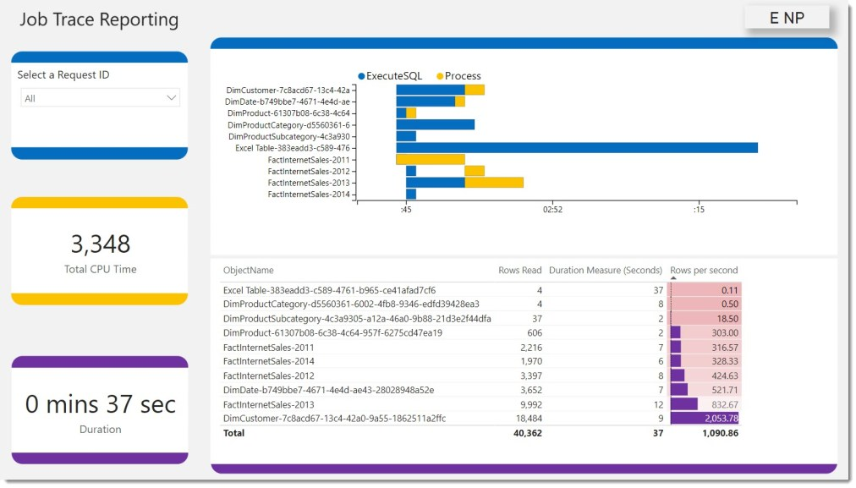
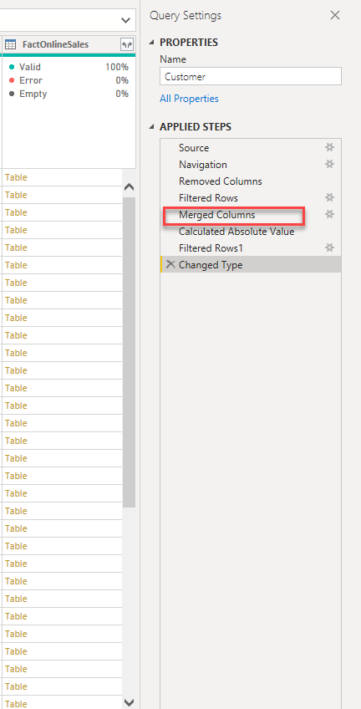
DATA REFRESH BEST PRACTICES
https://dax.tips/2021/02/15/visualise-your-power-bi-refresh/
Push transformations/calculations as close to a data source as possible
Create database views
ALL or NOTHING
Turn off Allow data preview to download in the background
@DataMozart
Notes:
Turn off Allow data preview to download in the background
Current File -> Data Load->
Why should you this? Well, when you are in Power Query Editor, you see preview of the data for every transformation step you’ve applied.
So, when you hit the refresh, it’s not only the amount of data that gets loaded into your dataset, but also a whole bunch of different queries to refresh this preview.
And in some situations, these queries take more time than loading data itself.
One important disclaimer here: this is happening only in Power BI Desktop!

Slide 15

DATA REFRESH PROCESS GOLDEN RULE
„Push transformations and calculations as upstream as possible,
and as downstream as necessary!“
Matthew Roche
@DataMozart

Slide 16

DAX CALCULATIONS

Slide 17
DAX CALCULATIONS
Unique customers, top-selling products, running totals...
The „beauty“ of DAX – get the same result in multiple different ways
Little nuances can make a huge difference!
@DataMozart

Slide 18
DAX CALCULATIONS
DEMO
@DataMozart
Notes:
So, what’s wrong with this measure? This measure returned correct results, but why is it so slow?
If I take a look at Server Timings, I will see that each query generated by the FE was quite fast, around 30ms…But, there were 1097 of them, which gives my total of 40 seconds!
Basically, what FE did here: for every materialized table of data returned by SE, it ran a distinct count against each set of data specified in our filter condition, date by date!
So, one query was ran for each date!
By providing a column as an argument of the FILTER function, instead of the whole Online Sales table, and wrapping it with the ALL function to remove all existing filters from the Sales Amount column, we managed to reduce the time for calculating our measure significantly.

Slide 19

VISUALS RENDERING TIME

Slide 20

VISUALS RENDERING TIME
Performance Analyzer feature in PBI Desktop
The more visuals – the longer time for rendering!
@DataMozart

Slide 21
VISUAL RENDERING
DEMO
@DataMozart

Slide 22
VISUALS RENDERING BEST PRACTICES
Reduce the number of visuals!
Use PowerPoint to design the background of the Power BI report page
Reduce the number of DAX queries generated – Card visuals->Matrix
Display aggregated data by default, enable Drill-through for details
Consider disabling cross-filtering
Sync Slicers?
@DataMozart
Notes:
4. Try to display data at high-level of grain. VertiPaq excels in vertical aggregations, but performs much worse on a detailed level reporting. With that in mind, if you have, let’s say a table with 20.000 rows, and some measures being calculated for each row, you should be better off keeping this high-level detail by taking advantage of drill-through feature. So, display aggregated data in the table by default, and then give user a possibility to drill-through to specific row if necessary

Slide 23

STORAGE MODE DECISION

Slide 24
WHAT IS A DIRECT QUERY?!
Data is retrieved from the source at the query time!
Data resides outside of Power BI before, during, and after the query execution
Direct Query will NEVER improve the performance of your Power BI report!!!
@DataMozart

Slide 25
WHEN TO USE A DIRECT QUERY?!
Data is too large for Import mode
Real-time reporting requirements
Is it really necessary?
Security policies on the data source side
@DataMozart

Slide 26


DIRECT QUERY BEST PRACTICES
Permissions on the data source?
Create proper indexes
Data integrity
Persistent data objects
Avoid complex PQ transformations
Avoid complex DAX measures
Avoid relationships on GUIDs
Limit parallelism and apply Query reduction
Check Assume referential integrity
@DataMozart
Notes:
Limit parallelism whenever possible – you can define the maximum number of connections that DQ can open at the same time. Go to Options->Current File->Published Dataset Settings. There are also some additional optimization options in the Query reduction tab. Basically, you can restrict slicers and filters, because by default when you change one slicer value, all the slicers will generate the query to a data source (even those which haven’t changed)!

Slide 27
DIRECT QUERY BEST PRACTICE!
AVOID DIRECT QUERY IF POSSIBLE!
@DataMozart

Slide 28

MONDAY TO-DO LIST
Identify the poor performing area(s)
Remove unnecessary data
Check Query folding
Be mindful when writing DAX
Reduce the number of visuals on the page
Stay away from Direct Query!
Notes:
You should keep in mind each of these points. But, if you asked me, one of them is slightly more significant, and that is the number one. Identifying which part of your Power BI solution is the root of the performance issues will help you to focus on solving a specific problem, rather than wasting time on less important stuff.

Slide 29

QUESTIONS
Data-mozart.com
@DataMozart

Slide 30

THANK YOU!
Dziękuję!
Data-mozart.com
@DataMozart

